Slide 1
Sitting in meetings all day long
My first 180 days as a new Software Engineering Manager
Dennis Dietrich Manager Software Development ICS, Phoenix Contact
Rev. 1 (2024-07-??), https://github.com/dennisdietrich/First180Days/
Notes:
YMWV – Your Mileage Will Vary

Slide 2
Overview
Getting ready
Leadership and management
Lessons in communication
Tactical and strategic staffing
Dealing with ”large" amounts
Reaching the next level

Slide 3
Getting ready

Slide 4
Getting ready Being a (tech) lead
Not a (full) line manager
Less to no coding
1-on-1s
Project management
Process improvement
Hiring

Slide 5
Getting ready Taking courses
edX MicroMasters Global Business Leadership and Management
Communicating and Negotiating in a Dynamic Global World
Global Leadership and Personal Development
Leading Digital and Data Decision Making
Company-provided (aspiring) manager training

Slide 6
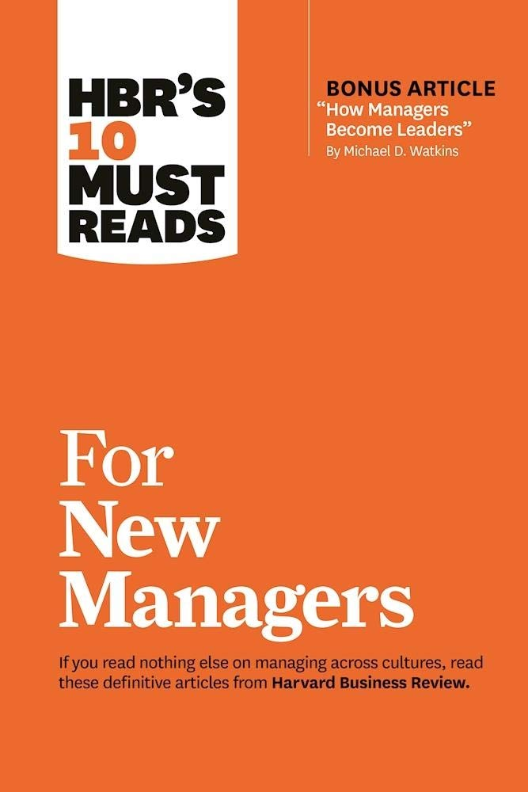
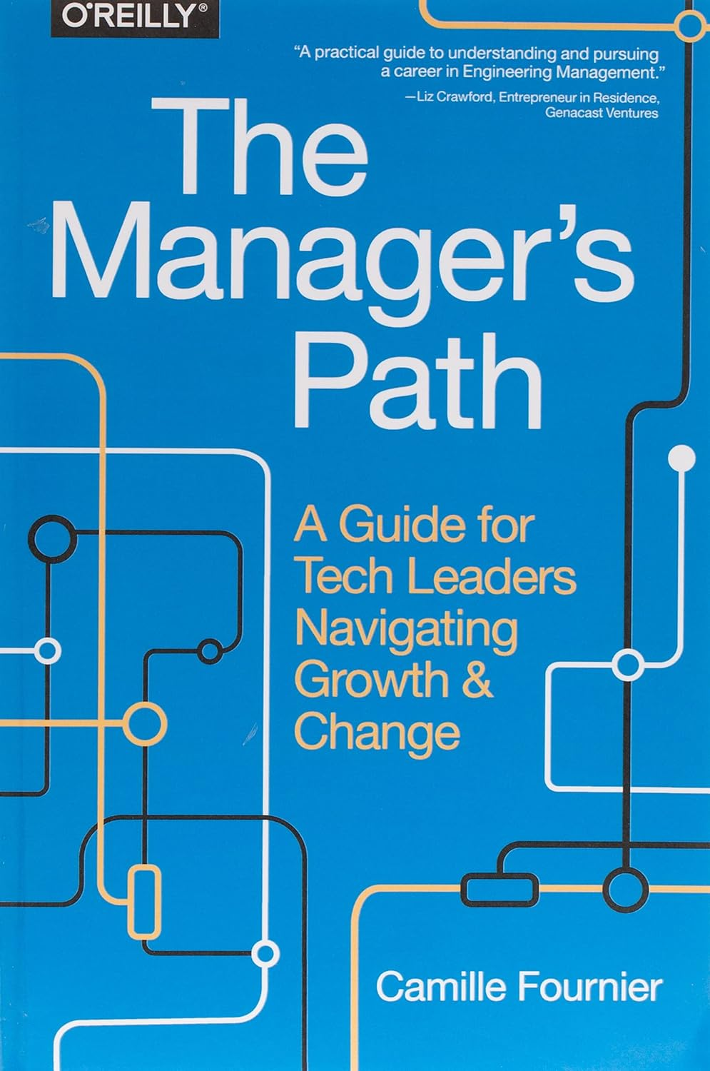
Getting ready Books and magazines I
HBR's 10 Must Reads for New Managers
Harvard Business Review Press
978-1633693029
The Manager's Path
Camille Fournier
O'Reilly Media
978-1491973899
Notes:
HBR's 10 Must Reads for New Managers (https://store.hbr.org/product/hbr-s-10-must-reads-for-new-managers-with-bonus-article-how-managers-become-leaders-by-michael-d-watkins/10134)
The Manager's Path (https://www.oreilly.com/library/view/the-managers-path/9781491973882/)

Slide 7


Getting ready Books and magazines II
Harvard Business Review
Harvard Business Publishing
0017-8012
The Culture Map
Erin Meyer
PublicAffairs
978-1610392761
Notes:
The Culture Map (https://erinmeyer.com/books/the-culture-map/)

Slide 8
Getting ready Looking back
Self-reflection
Role models…
…and negative role models

Slide 9
Leadership and management

Slide 10
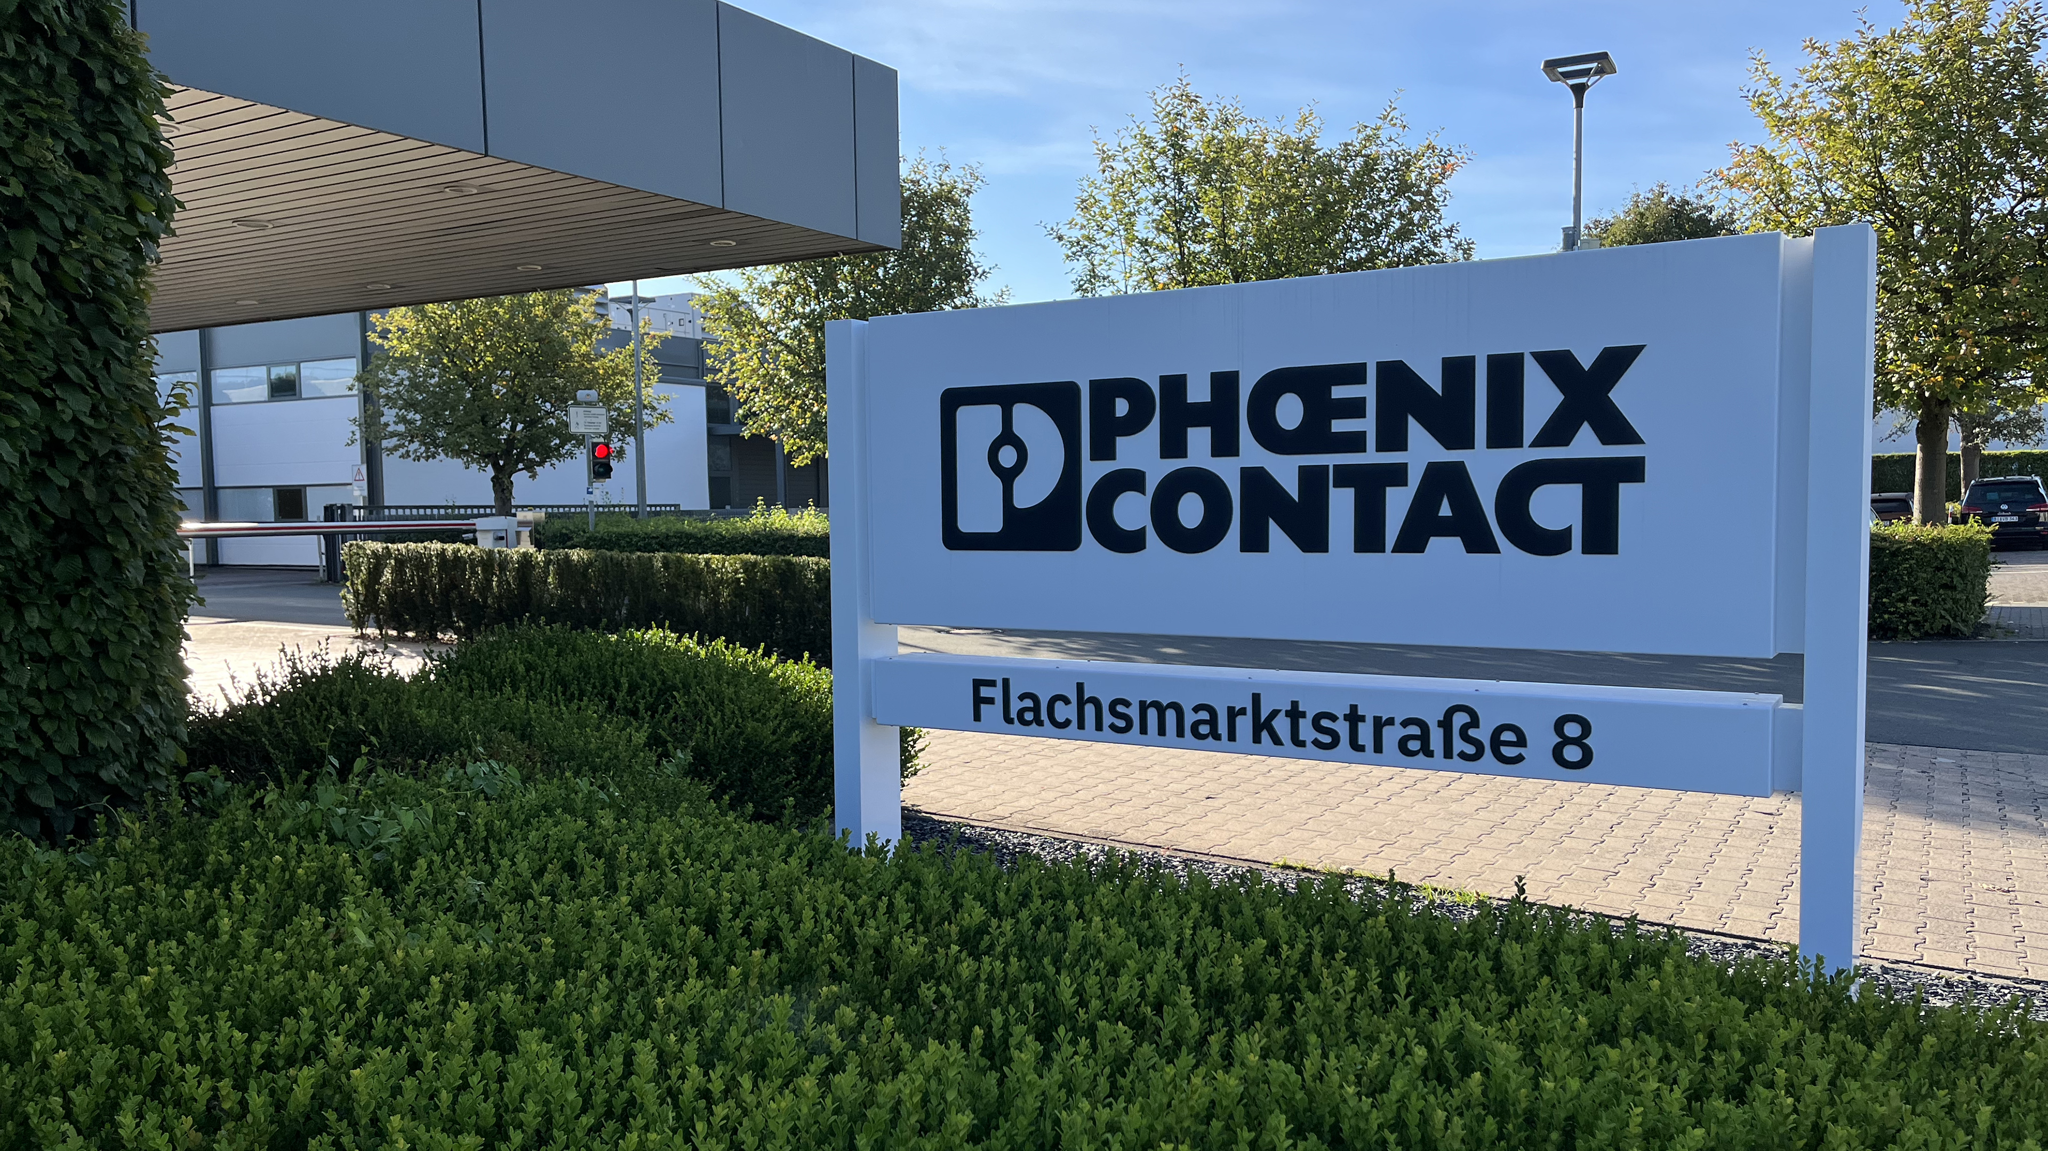
Leadership and management Stepping into the room…
Notes:
Photo taken on Monday 2023-09-04

Slide 11
Leadership and management Definitions
Management “is the process of managing the resources of businesses, governments, and other organizations” https://en.wikipedia.org/wiki/Management
Leadership “encompasses the ability of an individual, group, or organization to 'lead', influence, or guide other individuals, teams, or entire organizations” https://en.wikipedia.org/wiki/Leadership

Slide 12
Leadership and management The three kinds of leaders
Formal leaders
With authority
Without authority
Informal leaders

Slide 13
Leadership and management Servant leadership
“It doesn’t make sense to hire smart people and tell them what to do. We hire smart people so they can tell us what to do.” - Steve Jobs

Slide 14
Leadership and management Career development
Happy where they are
Getting to the next level (e.g., Senior Software Engineer)
Technical Leadership (e.g., Tech Lead, Architect, or Systems Engineer)

Slide 15
Leadership and management Types of management styles I
Laissez-faire
Career development, annual goals, regular 1-on-1s
Technical leadership (e.g., tech leads and architects)
Allow the team to fail!
Democratic
Deadlocked team
Role of moderator and advisor

Slide 16
Leadership and management Types of management styles II
Autocratic
Last resort!
Deadlocked team
Team cannot be allowed to fail
Performance or behavior issues

Slide 17
Leadership and management About fine print
Internal policies
NDAs
Contracts
Laws

Slide 18
Leadership and management Out of my comfort zone
Defining and improving processes
Introducing new roles
Performance management
Performance evaluation
Annual goals
Staffing reductions

Slide 19
Lessons in communication

Slide 20
Lessons in communication Reading between the lines

Slide 21
Lessons in communication They’ll listen… to something
New Manager, Enterprise Application Architect, Student Employee
Me: So, what about end-to-end testing?
Architect: Well, in customer journey testing…
Me: Okay, but what about the end-to-end test?!
Architect: As I explained, we have customer journey tests in which…
Me: That’s great, but I still don’t understand what we’re doing for end-to-end testing.
Student: (Crap! The new boss is getting rid of testing…)
(I might be out of a job!)
In marketing, the notion of customer journey portrays the process customers go through to establish a commercial relationship with a firm. The journey emphasizes touchpoints, which are the moments in which firms can interact with their current or potential customers.
https://en.wikipedia.org/wiki/Customer_experience#Customer_journey
Notes:
Also mention how asking the student about the Galen Framework was interpreted as an ask to evaluate it.
And also mention the story about someone from the hardware team remembering me talking about “having the team’s back”.

Slide 22
Lessons in communication "Managing" in all sorts of directions
Managing up
Managing laterally

Slide 23
Tactical and strategic staffing

Slide 24
Tactical and strategic staffing Tactical (short-term)
Planning for the next 12 months
Project assignments
Options for additional capacity
Non-FTE and fixed-term staff
Staff on loan from other departments

Slide 25
Tactical and strategic staffing Strategic (long-term)
Planning for the next 3-5 years
Understand where the business is going
Assess needed roles and headcount
Non-FTEs for vetting and training potential future FTEs
Don’t assume what people are interested in

Slide 26
Dealing with "large" amounts

Slide 27
Dealing with "large" amounts From retail to buying in bulk…
Functional Programming with C#, Simon Painter
I need the book: $45
My team needs the book: $450
Required reading for the company: $4,500
JetBrains All Products Pack
I need a subscription: €780 p.a.
My team needs subscriptions: €7,800 p.a.
It’s the standard for the company: €78,000 p.a.

Slide 28
Dealing with "large" amounts …to labor costs
External developer for a quarter (at €90/h): €43,200
An additional (Junior) Software Engineer: €56,000-61,000 p.a.
An additional Senior Software Engineer: €78,000-84,000 p.a.
New team of 10 Software Engineers: > €800,000 p.a.
Notes:
External developer for a year (at €90/h): €172,800

Slide 29
Reaching the next level

Slide 30



Reaching the next level More reading and courses!

Slide 31
Reaching the next level …and to what end?
Engineering management
Group Manager/ Director of Engineering
VP of Software Engineering
CTO
General management
CEO, Business Unit VP, Product Unit Manager
P&L responsibilities
Broad oversight across functions

Slide 32
Reaching the next level Formal education

Slide 33



Questions?
dennisdietrich
dcdietrich
@dc@social.advancedsoftware.engineering

Slide 34
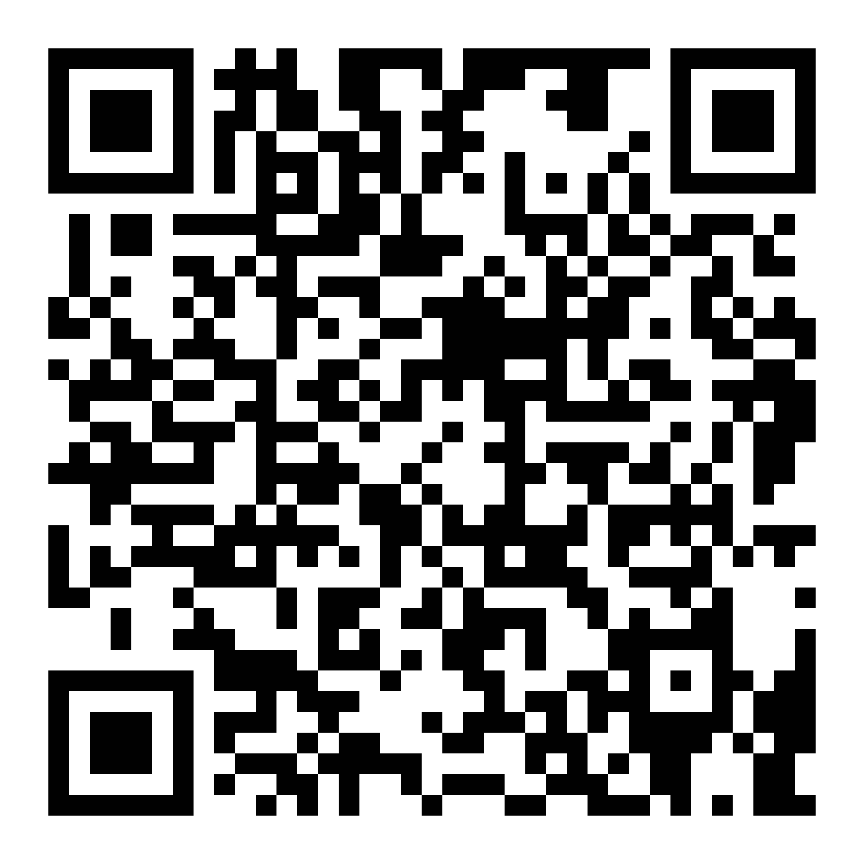
Thanks for listening!
dennisdietrich
dcdietrich
@dc@social.advancedsoftware.engineering

